Slide 1
Prediction of House Prices Using Multiple Linear Regression
Team: Datalysts
Aniket Dalvi
Ce Ji
Prasad Marathe
Qimei Wang

Slide 2
Introduction
Goal: To predict house prices in King County by identifying significant factors
Data Set: 21613 observations and 19 Variables
Response Variable: House Price
Key Independent Variables:
Bedrooms
Bathrooms
Square Feet Living
Square Feet of Lot
Floors
Water Front View
Condition
Zip Code

Slide 3
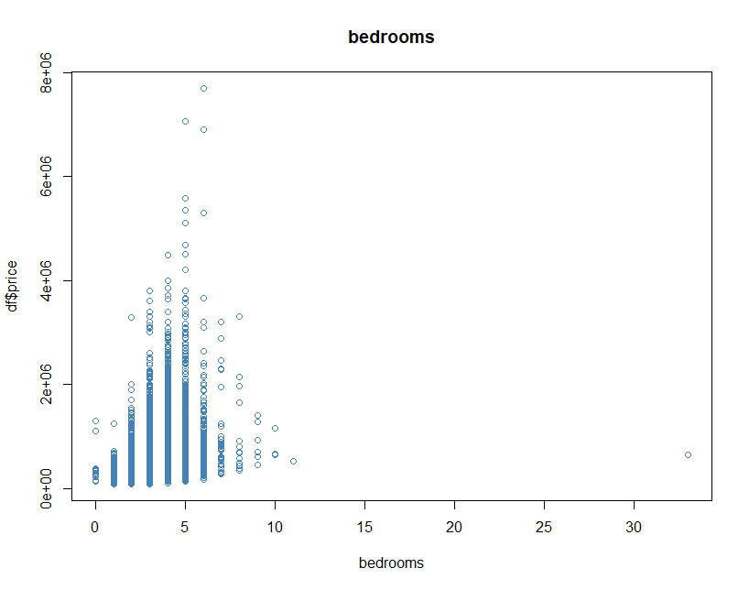
Exploratory Data Analysis
No Missing Values in the dataset
Data Cleaning:
Mean Sqft_Living of 3 bedroom house = 1805
Sqft_Living of 33 bedroom house = 1620
33 bedroom house cannot have 1.75 bathroom
Outlier in bedrooms with value 33 updated to 3

Slide 4
Correlation
 | price | bedrooms | bathrooms | sqft_living | sqft_lot | floors | waterfront | view | condition | grade | sqft_above | sqft_basement | yr_built | yr_renovated | zipcode | lat | long | sqft_living15 | sqft_lot15
price | 1 | 0.31 | 0.53 | 0.7 | 0.09 | 0.26 | 0.27 | 0.4 | 0.04 | 0.67 | 0.61 | 0.32 | 0.05 | 0.13 | -0.05 | 0.31 | 0.02 | 0.59 | 0.08
bedrooms | 0.31 | 1 | 0.52 | 0.58 | 0.03 | 0.18 | -0.01 | 0.08 | 0.03 | 0.36 | 0.48 | 0.3 | 0.15 | 0.02 | -0.15 | -0.01 | 0.13 | 0.39 | 0.03
bathrooms | 0.53 | 0.52 | 1 | 0.75 | 0.09 | 0.5 | 0.06 | 0.19 | -0.12 | 0.66 | 0.69 | 0.28 | 0.51 | 0.05 | -0.2 | 0.02 | 0.22 | 0.57 | 0.09
sqft_living | 0.7 | 0.58 | 0.75 | 1 | 0.17 | 0.35 | 0.1 | 0.28 | -0.06 | 0.76 | 0.88 | 0.44 | 0.32 | 0.06 | -0.2 | 0.05 | 0.24 | 0.76 | 0.18
sqft_lot | 0.09 | 0.03 | 0.09 | 0.17 | 1 | -0.01 | 0.02 | 0.07 | -0.01 | 0.11 | 0.18 | 0.02 | 0.05 | 0.01 | -0.13 | -0.09 | 0.23 | 0.14 | 0.72
floors | 0.26 | 0.18 | 0.5 | 0.35 | -0.01 | 1 | 0.02 | 0.03 | -0.26 | 0.46 | 0.52 | -0.25 | 0.49 | 0.01 | -0.06 | 0.05 | 0.13 | 0.28 | -0.01
waterfront | 0.27 | -0.01 | 0.06 | 0.1 | 0.02 | 0.02 | 1 | 0.4 | 0.02 | 0.08 | 0.07 | 0.08 | -0.03 | 0.09 | 0.03 | -0.01 | -0.04 | 0.09 | 0.03
view | 0.4 | 0.08 | 0.19 | 0.28 | 0.07 | 0.03 | 0.4 | 1 | 0.05 | 0.25 | 0.17 | 0.28 | -0.05 | 0.1 | 0.08 | 0.01 | -0.08 | 0.28 | 0.07
condition | 0.04 | 0.03 | -0.12 | -0.06 | -0.01 | -0.26 | 0.02 | 0.05 | 1 | -0.14 | -0.16 | 0.17 | -0.36 | -0.06 | 0 | -0.01 | -0.11 | -0.09 | 0
grade | 0.67 | 0.36 | 0.66 | 0.76 | 0.11 | 0.46 | 0.08 | 0.25 | -0.14 | 1 | 0.76 | 0.17 | 0.45 | 0.01 | -0.18 | 0.11 | 0.2 | 0.71 | 0.12
sqft_above | 0.61 | 0.48 | 0.69 | 0.88 | 0.18 | 0.52 | 0.07 | 0.17 | -0.16 | 0.76 | 1 | -0.05 | 0.42 | 0.02 | -0.26 | 0 | 0.34 | 0.73 | 0.19
sqft_basement | 0.32 | 0.3 | 0.28 | 0.44 | 0.02 | -0.25 | 0.08 | 0.28 | 0.17 | 0.17 | -0.05 | 1 | -0.13 | 0.07 | 0.07 | 0.11 | -0.14 | 0.2 | 0.02
yr_built | 0.05 | 0.15 | 0.51 | 0.32 | 0.05 | 0.49 | -0.03 | -0.05 | -0.36 | 0.45 | 0.42 | -0.13 | 1 | -0.22 | -0.35 | -0.15 | 0.41 | 0.33 | 0.07
yr_renovated | 0.13 | 0.02 | 0.05 | 0.06 | 0.01 | 0.01 | 0.09 | 0.1 | -0.06 | 0.01 | 0.02 | 0.07 | -0.22 | 1 | 0.06 | 0.03 | -0.07 | 0 | 0.01
zipcode | -0.05 | -0.15 | -0.2 | -0.2 | -0.13 | -0.06 | 0.03 | 0.08 | 0 | -0.18 | -0.26 | 0.07 | -0.35 | 0.06 | 1 | 0.27 | -0.56 | -0.28 | -0.15
lat | 0.31 | -0.01 | 0.02 | 0.05 | -0.09 | 0.05 | -0.01 | 0.01 | -0.01 | 0.11 | 0 | 0.11 | -0.15 | 0.03 | 0.27 | 1 | -0.14 | 0.05 | -0.09
long | 0.02 | 0.13 | 0.22 | 0.24 | 0.23 | 0.13 | -0.04 | -0.08 | -0.11 | 0.2 | 0.34 | -0.14 | 0.41 | -0.07 | -0.56 | -0.14 | 1 | 0.33 | 0.25
sqft_living15 | 0.59 | 0.39 | 0.57 | 0.76 | 0.14 | 0.28 | 0.09 | 0.28 | -0.09 | 0.71 | 0.73 | 0.2 | 0.33 | 0 | -0.28 | 0.05 | 0.33 | 1 | 0.18
sqft_lot15 | 0.08 | 0.03 | 0.09 | 0.18 | 0.72 | -0.01 | 0.03 | 0.07 | 0 | 0.12 | 0.19 | 0.02 | 0.07 | 0.01 | -0.15 | -0.09 | 0.25 | 0.18 | 1

Slide 5
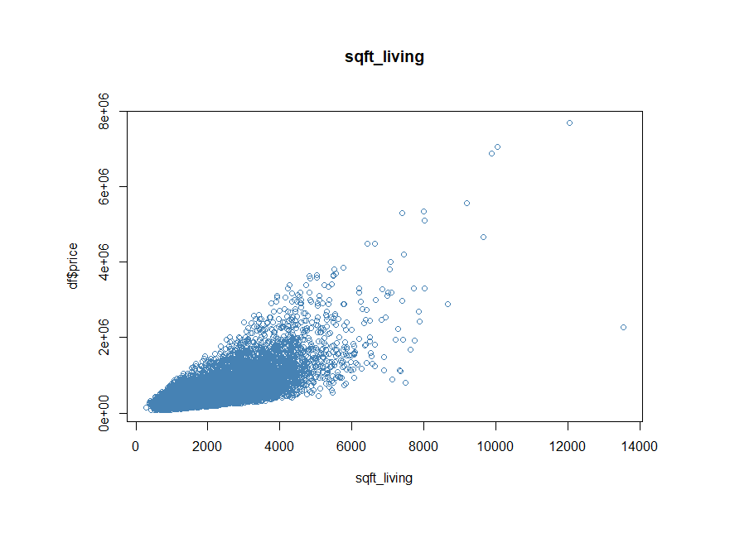
Scatter Plot of Price ~ Sqft Living
High Correlation between Price and Sqft Living, r = 0.7

Slide 6
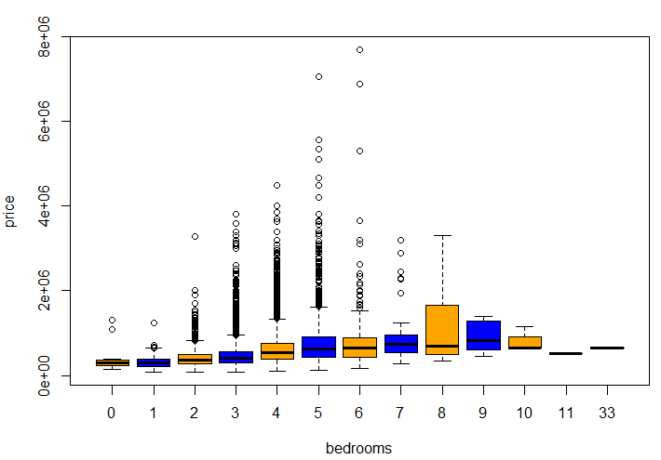
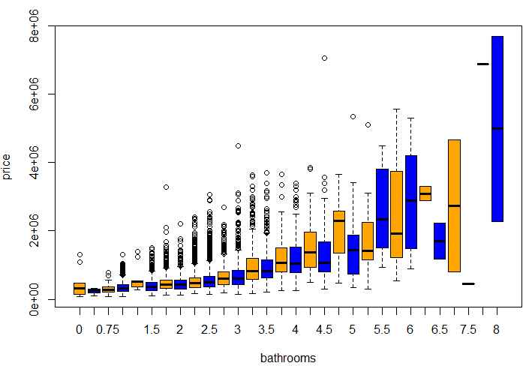
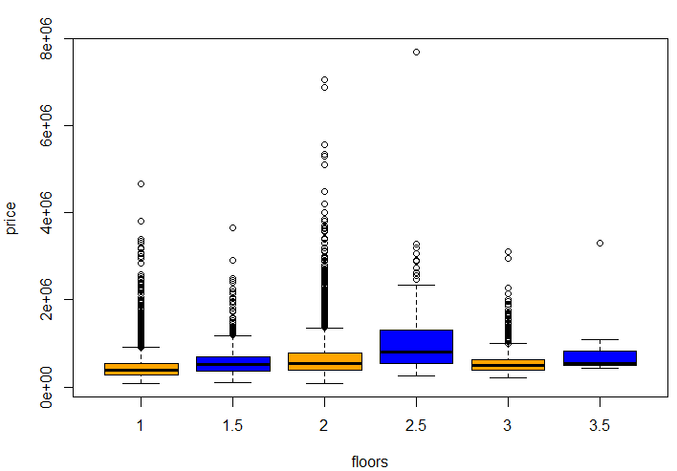
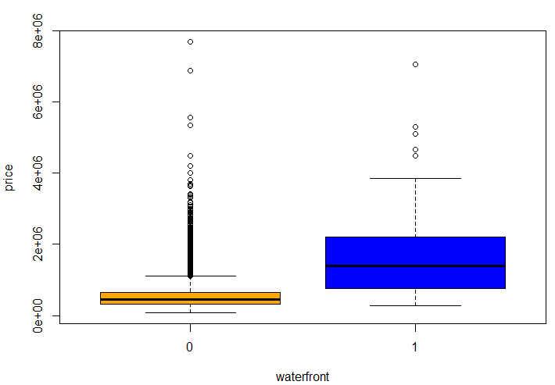
Box Plots for Categorical Variables vs price

Slide 7
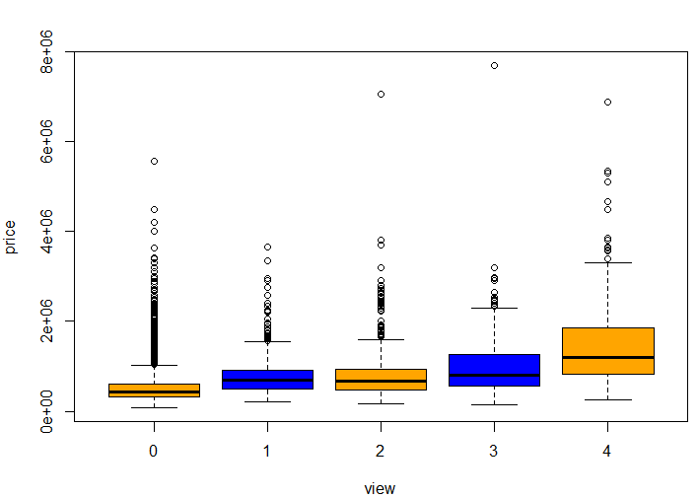
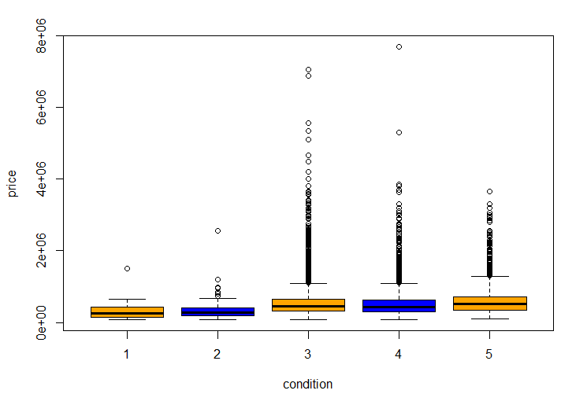
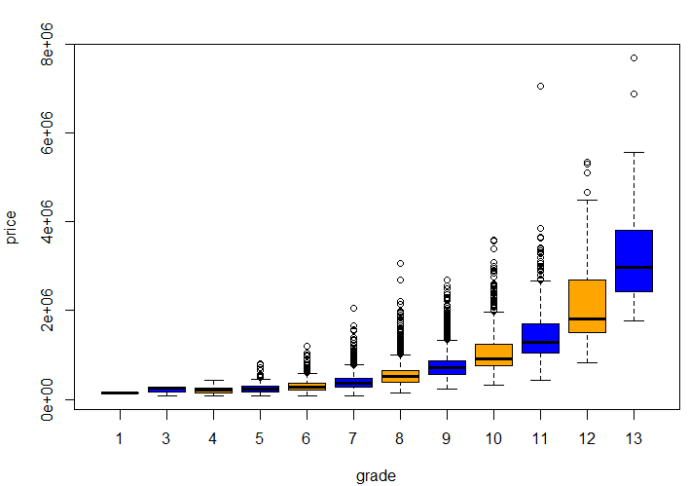
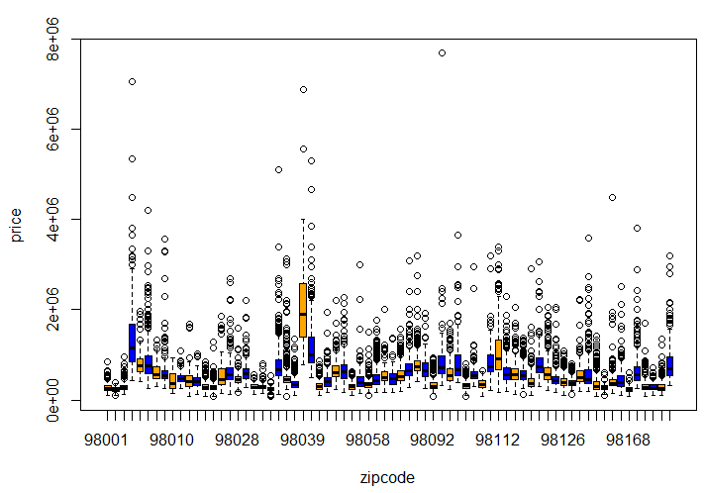
Box Plots of Categorical variables vs Price

Slide 8
Hypothesis
Effect of Sqft Living
Important criteria for anyone looking to purchase a house
Effect of Bathrooms
Having more bathrooms will increase price
Effect of Bedrooms
The basic building block of a house

Slide 9
“Best” Model
Train
17290 observations
19 variables
Test
4323 observations
19 variables
80%
20%
Notes:
For Model Validation

Slide 10
Assumptions for Linear Regression Model
Relationship between price (response) and independent variables is linear, at least approximately.
The errors are normally distributed.
3. The errors have constant variance.

Slide 11
Best Model
Selecting Subset of Variables for Building Full Model
bedrooms
bathrooms
sqft_living
sqft_lot
floors
waterfront
view
condition
grade
zipcode

Slide 12
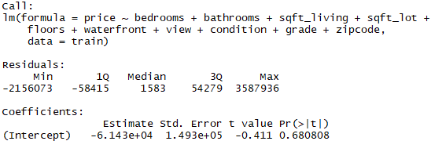
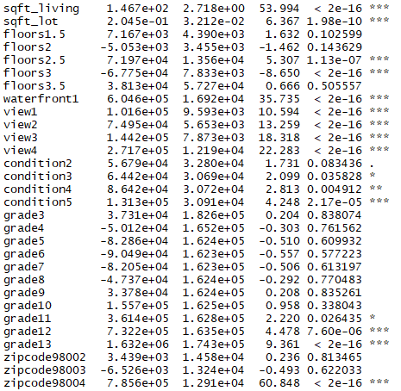

Model Building: Model 1
Model 1 :
Significant Predictors
Sqft_Living
Sqft_lot
Bathrooms
Floors
Waterfront
View
Condition
Grade
ZipCode
Bedrooms not as significant compared to other variables in the model
R² = 0.8384, Adjusted R² = 0.8371, Residual Error = 147900
Backward Elimination Method → Eliminate bedrooms in next iteration

Slide 13
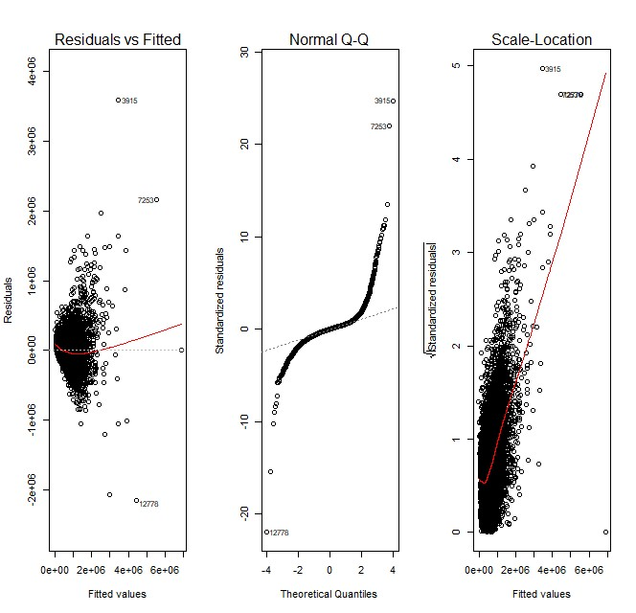
Model 1 Adequacy Check

Slide 14
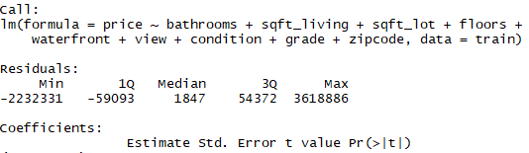
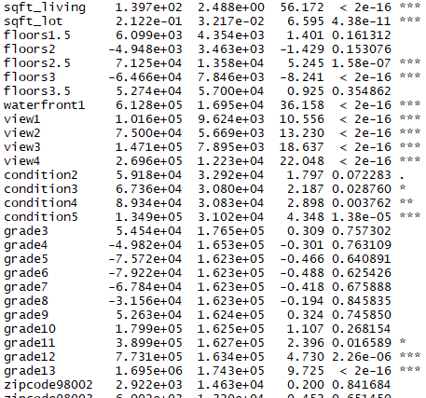

Model Building: Model 2
Model 2 :
Significant Predictors
Sqft_Living
Sqft_lot
Bathrooms
Floors
Waterfront
View
Condition
Grade
ZipCode
R² = 0.837, Adjusted R² = 0.8358,
Residual Error = 148400

Slide 15
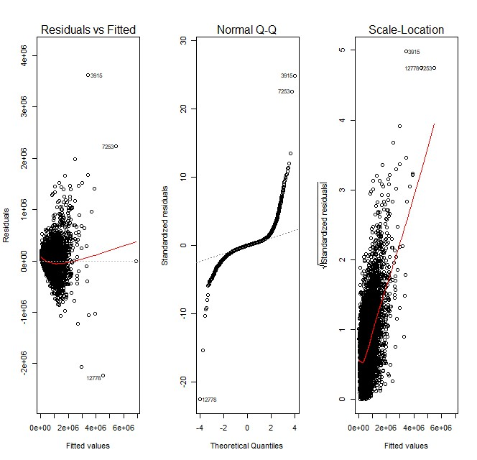
Model 2 Adequacy Check

Slide 16
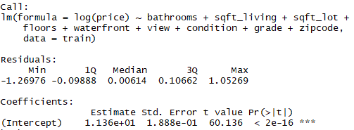
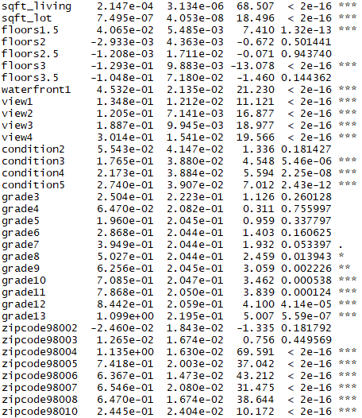

Model Building: Model 3
Model 3 :
Significant Predictors
Sqft_Living
Sqft_lot
Bathrooms
Floors
Waterfront
View
Condition
Grade
ZipCode
R² = 0.8746, Adjusted R² = 0.8737
Residual Error = 0.187

Slide 17
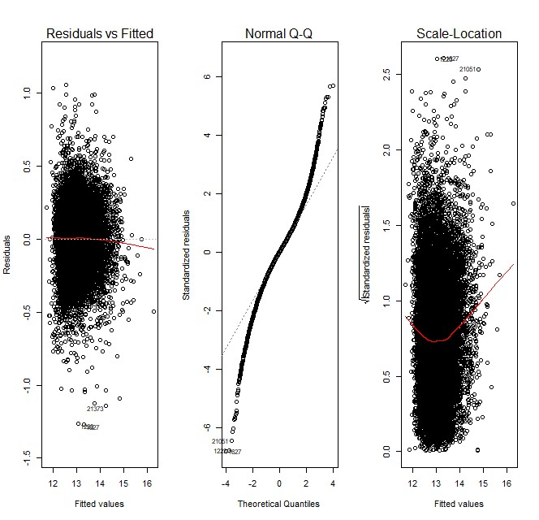
Model 3 Adequacy Check

Slide 18

Prediction
RMSE = 143459.6
R-Squared = 0.86

Slide 19
Conclusion
In this study, we followed the multiple linear regression technique to explore the relationship between predictors like sqft_living, bathrooms, grade, etc. and response variable i.e. price of the house.
The independent variable bathroom and sqft_living were the significant influencer. So, this confirms our first two hypothesis.
The bedrooms did not seem to have much influence on the price of the house. So, we reject the third hypothesis.

Slide 20
Thank You!

